Slide 1
Generate And Test In Aiml
SlideMake.com

Slide 2
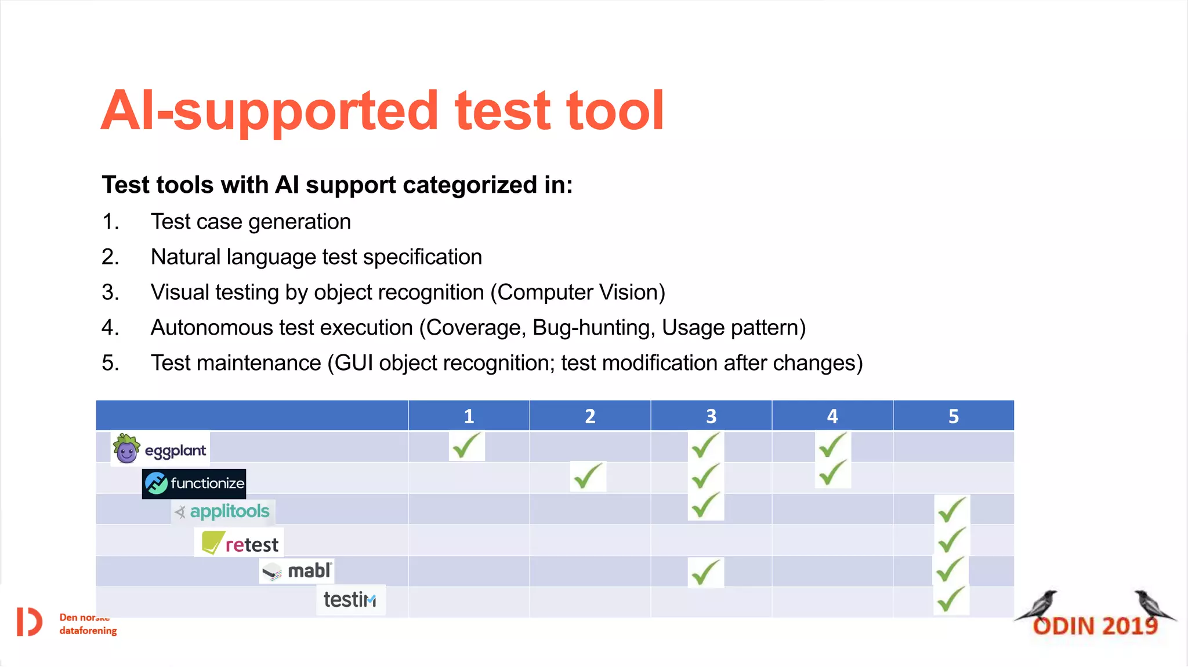
Introduction to Generate and Test in AIML
Generate and Test is a common problem-solving approach used in artificial intelligence.
It involves generating potential solutions and then testing them for validity.
AIML, primarily used for creating chatbots, can incorporate this method for more dynamic interactions.
1
Notes:
Image source: https://image.slidesharecdn.com

Slide 3
Overview of Generate and Test Methodology
The generate phase involves creating possible solutions or responses.
The test phase evaluates each generated option against predefined criteria.
This iterative process continues until a suitable solution is found or resources are exhausted.
2
Notes:
Image source: https://i1.rgstatic.net

Slide 4

Relevance to AIML Development
AIML primarily uses pattern matching but can simulate generate and test strategies.
Developers can script multiple response options and evaluate their appropriateness dynamically.
Incorporating generate and test enhances a chatbot’s ability to handle complex queries effectively.
3
Notes:
Image source: https://www.iiqf.org

Slide 5
Basic Structure in AIML
AIML uses categories to define patterns and responses.
To implement generate and test, multiple categories can be created for different response options.
Scripted logic can prioritize or filter responses based on context or user input.
4
Notes:
Image source: https://www.researchgate.net

Slide 6
Example of Generate and Test in AIML
Example: Generating multiple responses to a question about weather.
Responses are stored in different categories with specific pattern matching.
The chatbot tests each response until it finds the most suitable one for the user’s query.
5
Notes:
Image source: https://image.slidesharecdn.com

Slide 7

Using Conditions for Testing Responses
AIML’s `<condition>` tag can evaluate previous responses or user inputs.
Conditions help filter or select responses based on context or variables.
This testing mechanism allows for more personalized and context-aware interactions.
6
Notes:
Image source: https://www.slidemake.com

Slide 8
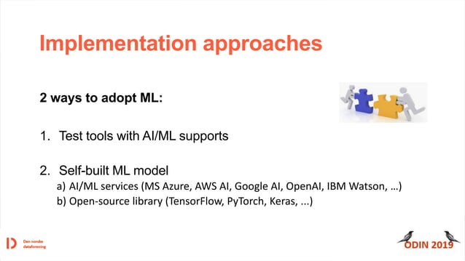
Implementing Generate and Test with Variables
Variables in AIML store user preferences or state information.
Generated responses can be tailored based on variable values during testing.
This dynamic testing improves the relevance of responses in ongoing conversations.
7
Notes:
Image source: https://image.slidesharecdn.com

Slide 9
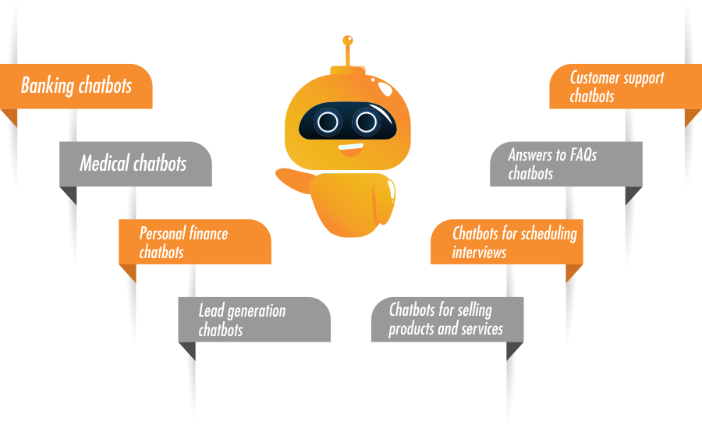
Advantages of Generate and Test in AIML
It increases the flexibility and adaptability of chatbots.
It allows handling ambiguous or complex user inputs more effectively.
This approach also helps in managing multiple potential responses efficiently.
8
Notes:
Image source: https://www.veetechnologies.com

Slide 10

Limitations and Challenges
Implementing generate and test can increase the complexity of AIML scripts.
It may lead to longer response times due to multiple testing cycles.
Proper design is essential to avoid infinite loops or inappropriate responses.
9
Notes:
Image source: https://trissential.com

Slide 11
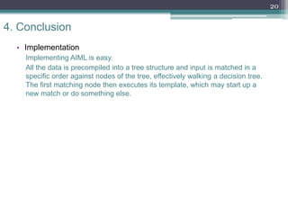
Conclusion and Future Directions
Generate and Test enhances AIML-based chatbots by making responses more dynamic.
Combining this approach with machine learning can further improve conversational abilities.
Ongoing research focuses on automating response generation and optimizing testing processes.
10
Notes:
Image source: https://image.slidesharecdn.com

